Slide 1
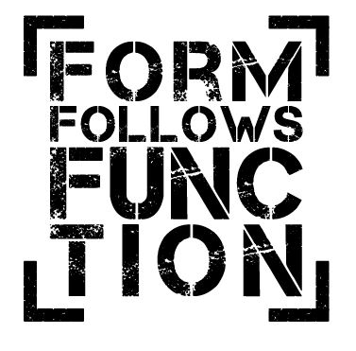
The Ditransitive Strategy
Cognitive Containment & Construction Design
John W. Du Bois
Nicholas A. Lester
Workshop:
“Dative constructions: Meaning, argument structure, and grammaticization”
Usage-Based Linguistics Conference
Tel Aviv, June 16, 2016
UCSB Linguistics

Slide 2
Issues
Why would you need a ditransitive strategy?
How do language users achieve rich expressivity in language production without overloading their limited cognitive resources?
Argument structure constructions
Complexity-building: intransitive → transitive → ditransitive
I gave em stickers
Preferred Argument Structure revisited

Slide 3
3-participant events
Humans have a profound interest in events that shape social relations between 2 humans (e.g giving)
But how can you fit 2 humans plus a gift in one clause?
We propose that the emergence of three-argument syntactic structures is constrained by a Constructional Preferred Argument Structure, which manages the limited cognitive resources available for processing core arguments.

Slide 4
How much is too much?
Experiment design by Ted Gibson’s lab:
The manager brought an architect to the engineer so they could discuss the plans.
The manager brought an architect the engineer so they could discuss the plans.
(Brown, Savova & Gibson 2012: 201)

Slide 5
Short to long… (Breen, Watson & Gibson 2011: 1571)
The grandmother gave the necklace to the grandson on Sunday.
The grandmother gave the necklace of twenty pearls to the grandson on Sunday.
The grandmother gave the necklace of twenty pearls to the grandson from Kansas City on Sunday.
The grandmother gave the necklace of twenty pearls to the grandson from Kansas City at the annual family reunion.
…or long and longer?

Slide 6
Less is more (naturally occurring discourse)
I gave em stickers
and I give stickers to the kids
we put that money in a clearing account
and I put some onion powder ... in the mayonnaise

Slide 7
The original Preferred Argument Structure
Cross-linguistic evidence from corpus studies
(Du Bois 1987; Du Bois 2003; Du Bois, Kumpf, and Ashby 2003)

Slide 8
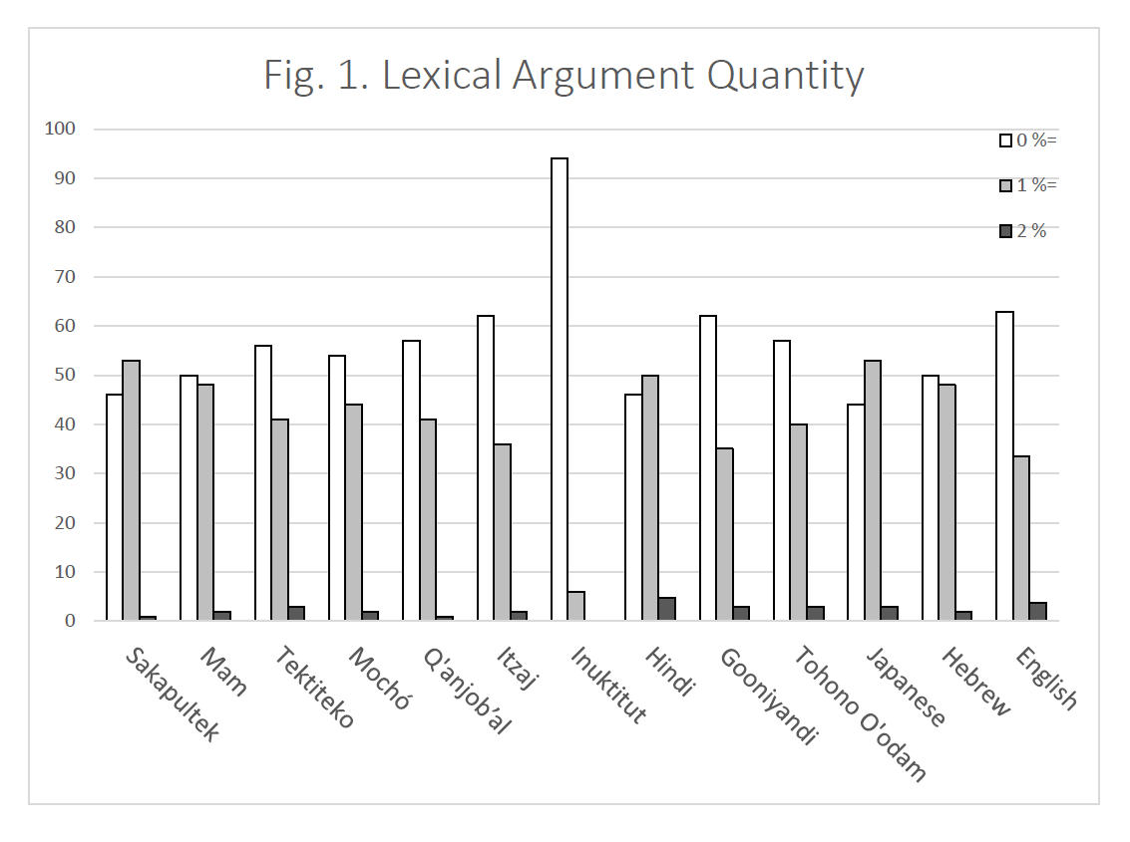
Lexical argument quantity Frequency of clauses with 0, 1, or 2 lexical core arguments
ergative
accusative

Slide 9
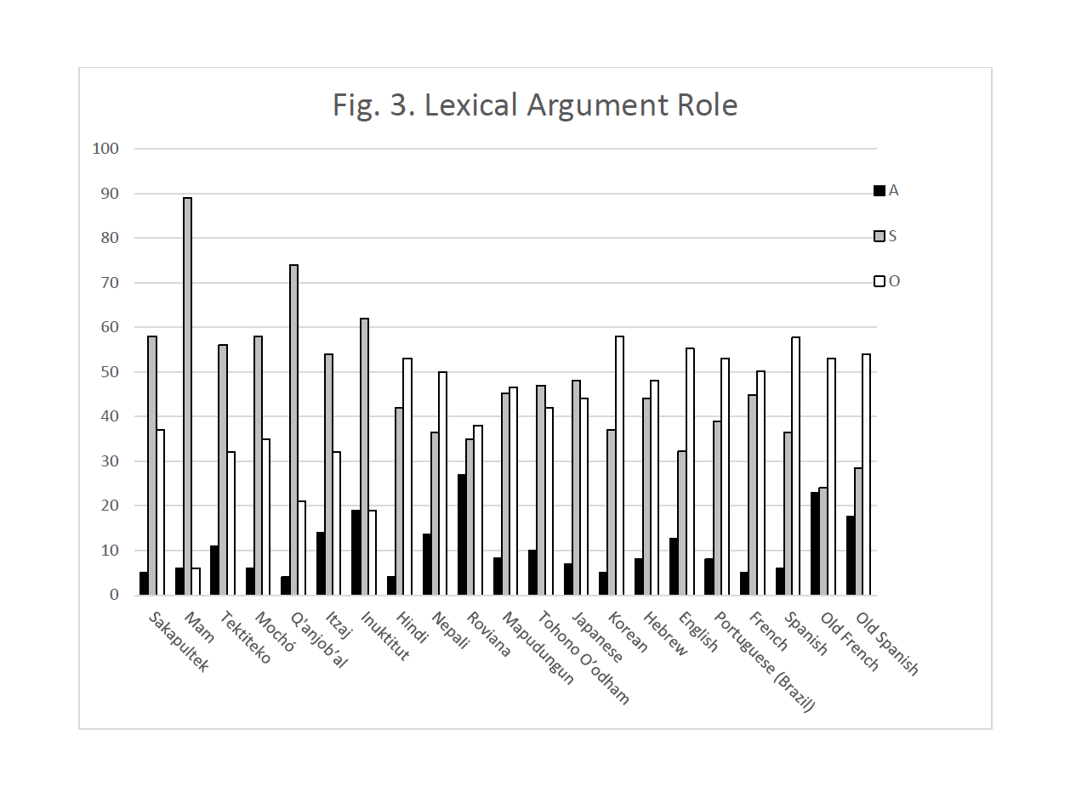
Lexical argument role Distribution of lexical arguments across A, S, and O
ergative
accusative

Slide 10
Preferred Argument Structure: 4 constraints
 | Pragmatics | Grammar
Quantity | Avoid more than one New core argument | Avoid more than one lexical core argument
Role | Avoid New A’s | Avoid lexical A’s

Slide 11
Original formulation of Preferred Argument Structure had its limitations
Dichotomy: Binary contrast between lexical vs. reduced (pronoun or zero) arguments
Expresses generalizations in the form of “whole-language typology” (about A, S, O in ergative or accusative languages)
No explicit analysis of constructions per se (but intransitive & transitive are implicit)
Limited discussion of 3-place predications (e.g. ditransitives)
Need to address various critiques (Dahl 2008, Haspelmath 2006, Everett 2009)

Slide 12
Constructional Preferred Argument Structure reflects new developments
Continuum: Continuously variable length of arguments, degree of accessibility
Focus on constructions (especially argument structure constructions)
Attention paid to 3-place predications (e.g. ditransitives)
Expresses typological generalizations in fine-grain grammar-internal resolution (constructions)
(Critiques to be addressed in future publications)

Slide 13
Pockets & platforms
Cognitive containment vs. free expressivity

Slide 14
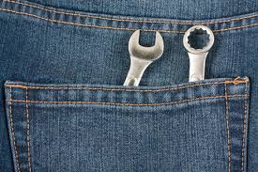



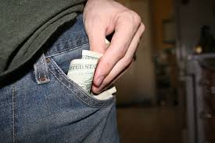
What can a pocket hold?

Slide 15
What can a pocket hold?
something useful
something small
it fits in the pocket
it’s attached to the body
it’s always with you
it lets you do more things
But…
it can’t hold everything

Slide 16
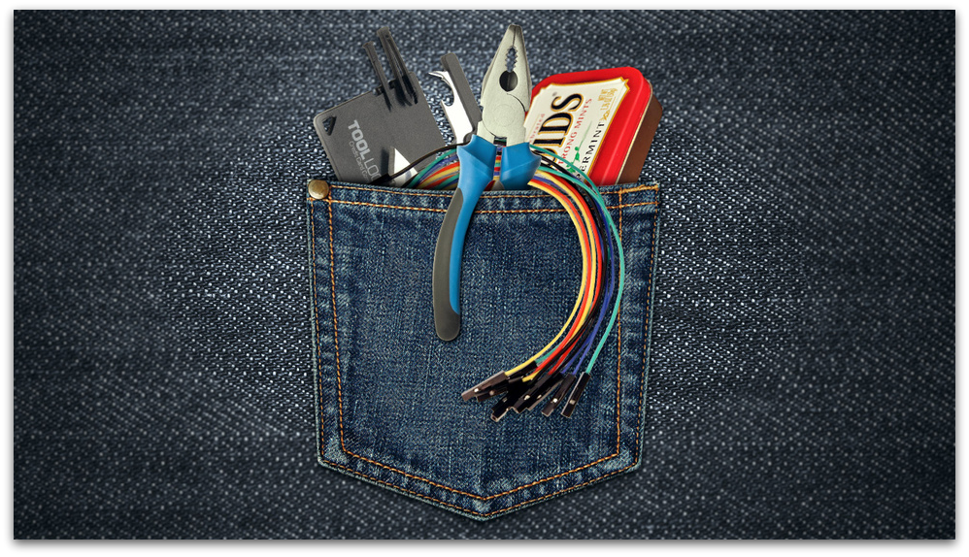

Avoid pocket overload— keep it simple!

Slide 17

What can a platform support?
→ locus of maximal attention for processing complexity
→ growth point for open-ended expansion & development

Slide 18
Viewed in terms of grammar…
a pocket supports:
a platform supports:
he
she
that
they
you
I
my father
a woman who sits here
some idea about that
the fourth-graders
you people in the media
your cutest daughter

Slide 19
Viewed in terms of cognition…
a pocket supports:
a platform supports:
short forms
simple structures
low cognitive demands
predictable work
low communicative risk
long forms
complex structures
high cognitive demands
unpredictable work
high communicative risk

Slide 20
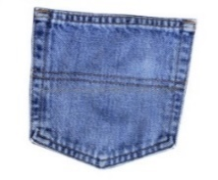

Pocket—Pocket—Platform: arT
(1) I gave em ten dollars,
a r T
(2) Can you give me a toothpick?
a r T
(3) I 'm gonna give you a mushy kiss.
a r T

Slide 21
No lower bound: Platforms allow pronouns
you can give me some idea about that as well.
a r T (SBC029)
so you can just give me that .
a r t (SBC043)
Notes:
(SBC029)
1 308.010 308.430 LARRY; And you can give --
2 308.430 310.550 you can give me some idea about that as well.
(SBC043)
1 779.591 780.797 ALICE; .. That's th- already open,
2 780.797 781.543 and I drank out of it,
3 781.543 782.535 so you can just give me that.

Slide 22
Platform as “growth point” (McNeill): It’s open-ended
we 'll give you the history on each one,
a r T
That can give you the scale for the size of the planets.
a r T

Slide 23
Platform as “growth point” (McNeill): It’s open-ended
… sh:e s- gave me the name of this other — this Amherst architect, who s- — … started two co-housing developments, in this area.

Slide 24

The “Single Dependent Constraint” (Du Bois 1987, 2003) One head licenses one platform
VERB
PREP

Slide 25
Double-object construction
VERB
A R G U M E N T S

Slide 26
Arguments + adjunct = ? (Ariel, Dattner, Du Bois & Linzen 2015)
?
?
VERB
PREP
?
A R G U M E N T S
A D J U N C T
A R G U M E N T S

Slide 27
Easy as 1-2-3 Cognitive containment affords expressive complexity
1
2
3

Slide 28
Our current study Dative alternation

Slide 29
Focus: Dative alternation
GIVE w/ Double-Object Construction
I gave em stickers
GIVE w/ Prepositional-Object Construction
and I give stickers to the kids

Slide 30
Contrast: PUT (no alternation)
Prepositional-Object w/ PUT
we put that money in a clearing account
and I put some onion powder ... in the mayonnaise
Structural analog to the ‘prepositional dative’

Slide 31
Data
Santa Barbara Corpus of Spoken American English
60 transcribed-spoken interactions
~250,000 words
Prosodic annotation: ~60,000 Intonation Units

Slide 32
Data Retrieval
Extracted all instances of give and put in the Santa Barbara Corpus (Du Bois et al. 2000-2005)
Annotated each token for verb & construction type
GIVE—double object (give_do)
GIVE—prepositional object (give_po)
PUT—prepositional object (put_po)
Excluded non-hits
and everyone had given up
Well I had given him up for dead
How do you put up with that
You can put in a ninety-minute tape
(etc.)
Notes:
QUERY 2016-4-14: Is this still valid? Should it be? What about legitimate zeros, alternative word orders? Does this bias results? Would it change significantly otherwise?

Slide 33
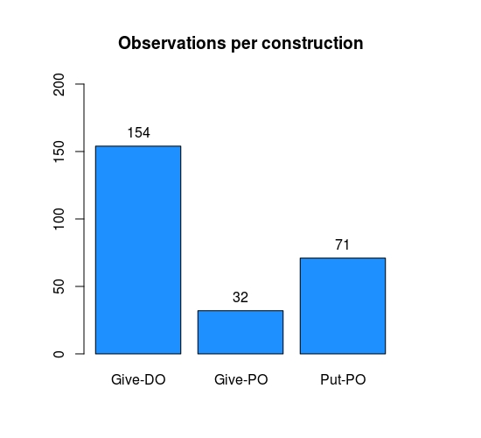
Observations per construction
GIVE GIVE PUT
Double-Obj Prep-Obj Prep-Obj
Notes:
Subset of clauses explored in this analysis

Slide 34
Dependent variable: Length
Length of arguments is based on # of characters in noun phrase
Value is log-transformed to approach normal distribution
Length is understood as a proxy for cognitive accessibility
This continuous variable (in comparison to the original binary lexical/non-lexical contrast of Preferred Argument Structure) provides a finer grain of resolution

Slide 35
Control Variables
Animacy
animate, inanimate
Prediction: animate < inanimate
(e.g. Givon 1983, Du Bois 1987, Everett 2009)
Person
first/second, third
Prediction: first/second < third
(essentially de facto)

Slide 36
Control Variables
Grammatical role
subject, direct object, indirect object, prep object
Prediction: sub/ind < dir obj < prep obj
(e.g. Du Bois 1987; Du Bois, Kumpf & Ashby, 2003; PAS)
Relative position in clause
non-final, final
Prediction: non-final < final
(e.g. Wasow 1997; Ferreira & Dell 2000)

Slide 37
Control Variables
Extra Intonation Unit (prosodic boundary between verb and argument)
no, yes
Prediction: no < yes
(e.g. Chafe 1979, 1994; Du Bois 1987, 2003)

Slide 38
Variables of interest
Thematic role
agent, recipient/goal, theme
Prediction: depends on arg structure construction
Partially specified Argument Structure Construction
give + double-object, give + prep-obj, put + prep-obj
Prediction: depends on thematic role
Notes:
From the constructional preferred argument structure, we should fully expect constructions at varying levels of specificity to develop different internal generalizations as a function of their distributions in discourse. Thus, we expect any effects of thematic role to be contingent on the argument structure construction in which they are embedded. We also expect strong asymmetries between argument lengths (at least between A and O). Hence, the constructional effects should depend on thematic role.

Slide 39
Critical interaction
Thematic Role : Verb + Argument Structure Construction
Prediction: ?
Notes:
However, any specific effects leading to differential argument loading across constructions are not predicted by the theory. Therefore, our analysis is exploratory, a first step towards quantitatively assessing the plausibility of constructional preferred argument structure.

Slide 40
Results
Linear mixed effects regression
Hierarchical elimination of factors
Random intercept adjustments for individual speakers

Slide 41
Variables
Animacy
Person
Grammatical role
Relative position
Extra Intonation Unit
Thematic role
Verb + Construction
Thematic role : Verb + Construction
Notes:
Here are the fixed effects again…

Slide 42
Significant predictors
Animacy
Person ***
Grammatical role
Relative position
Extra Intonation Unit ***
Thematic role *
Verb + Construction
Thematic role : Verb + Construction ***
Notes:
And here are the significant predictors. Notice that Animacy, which has frequently been cited in claims that PAS amounts to an epiphenomenon, did not survive model selection. Thus, we find no evidence that animacy plays a significant (independent!) role in determining argument length within these constructions.

Slide 43
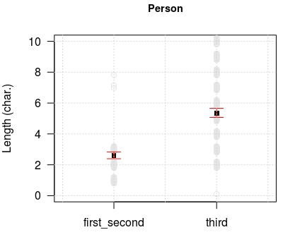
Person: 1st/2nd vs. 3rd
Notes:
Person, essentially a given, but confirms that speakers do use third-person lexical arguments from time to time!

Slide 44
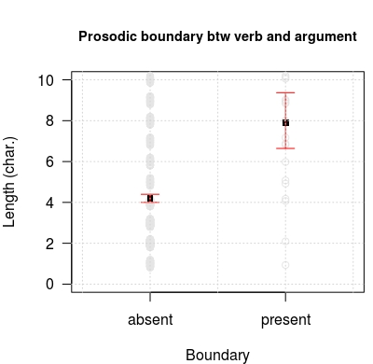
Extra Intonation Unit
Notes:
Prosodic boundary: supports Chafe’s characterization of the intonation unit as a basic unit of production processing. When a new processing domain is opened (as indicated by the initiation of a new IU), speakers can put more into their lexical arguments (in the majority of cases, the IU separates the final, and hence heaviest, argument).

Slide 45
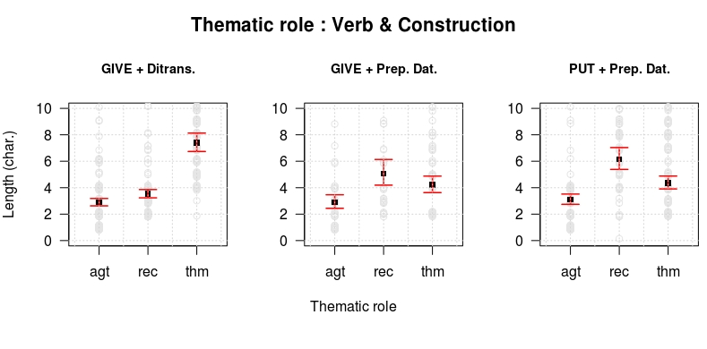
Thematic role : Verb + construction
GIVE GIVE PUT
Double-Obj Prep-Obj Prep-Obj
AGT REC THM AGT REC THM AGT REC THM
Thematic Role
Notes:
Critical result: ASCs differ systematically in the loading of argument lengths. Data suggest a trade-off in lexicality of post-verbal arguments beyond a simple ‘heavy last’ consideration. In other words, within a construction, the smaller your pockets, the bigger your platforms. Suggested by the apparent ‘downward tug’ of the inflated theme arguments on recipient lengths in prepositional object. Also suggestive of an explanation in terms of diachrony: perhaps the more heavily grammaticized ditransitive (given the lack of a PP) has optimized its informational loading to cohere more strongly with the preceding discourse. Or perhaps there is a general drive towards single-platform structure, similar to what Chafe has suggested with the maxim ‘one new idea per utterance.’

Slide 46
Conclusions

Slide 47
Easy as 1-2-3 Cognitive containment affords expressive complexity
1
2
3

Slide 48
Conclusions
The Cognitive Containment Strategy balances support for expressive complexity with effective management of limited resources
Argument structure constructions differ in their specialized (but motivated) strategies for how to load information/content across their argument slots.
Argument slots in constructions are distinguished by observable differences in argument length as a proxy for accessibility.
Notes:
NL: Tools for modulating entity cohort salience via length-based signaling?

Slide 49
Directions for future research
We need more:
Accessibility measures
Verb types (ditransitive-biased verbs)
Diverse Argument Structure Constructions (intransitive, transitive, ditransitive; complement-taking predicates; existential/presentative there; etc.)
Corpora (other datasets)
Languages (typological diversity)
Grammaticization studies (evidence from discourse, typology & language change)
Experiments (testing predictions on accessibility, cognitive load, and the Cognitive Containment Strategy)

Slide 50
Thank you!

